Slide 1
Micro Brewery Exploratory Data Analysis
Authors: Jeff Nguyen and Adam Ruthford

Slide 2
Breweries by state Question 1
State | Brewery Count | State | Brewery Count | State | Brewery Count
AK | 7 | KY | 4 | NY | 16
AL | 3 | LA | 5 | OH | 15
AR | 2 | MA | 23 | OK | 6
AZ | 11 | MD | 7 | OR | 29
CA | 39 | ME | 9 | PA | 24
CO | 47 | MI | 32 | RI | 5
CT | 8 | MN | 11 | SC | 4
DC | 1 | MO | 9 | SD | 1
DE | 2 | MS | 2 | TN | 3
FL | 15 | MT | 9 | TX | 28
GA | 7 | NC | 19 | UT | 4
HI | 4 | ND | 1 | VA | 16
IA | 5 | NE | 5 | VT | 10
ID | 5 | NH | 3 | WA | 23
IL | 18 | NJ | 3 | WI | 20
IN | 22 | NM | 4 | WV | 1
KS | 3 | NV | 2 | WY | 4
Notes about data:
Duplicates for two breweries were removed from the data: Summit Brewing Company of St Paul, MN and Sly Fox Brewing Company of Phoenixville, PA Summit brewing had two entries with one having a value for city of “St. Paul” instead of “St Paul”.
Sly Fox had locations in both Phoenixville and Pottstown PA. The two town are less than ten miles apart.

Slide 3
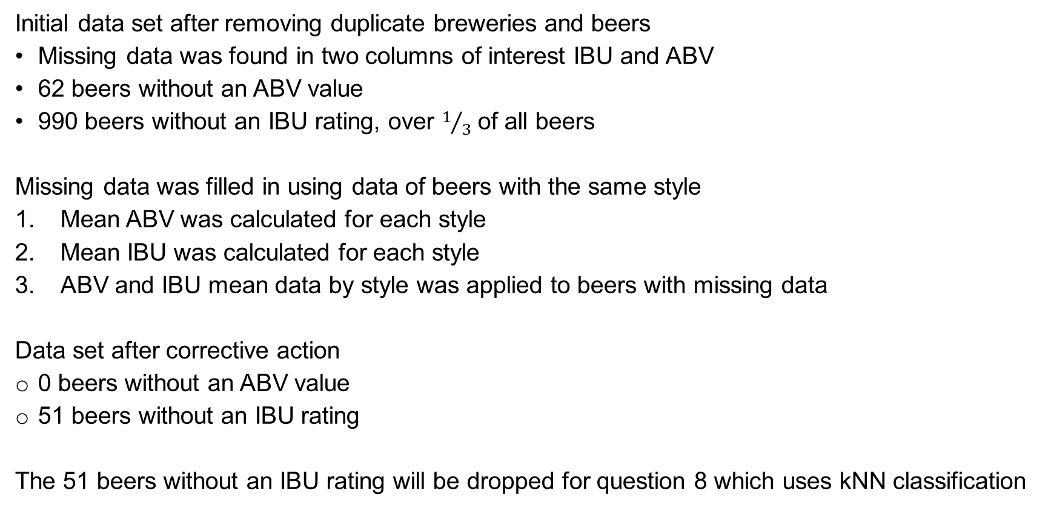
Missing values in the Beer data Question3
Initial data set after removing duplicate breweries and beers
Missing data was found in two columns of interest IBU and ABV
62 beers without an ABV value
990 beers without an IBU rating, over $1/3$ of all beers
Missing data was filled in using data of beers with the same style
Mean ABV was calculated for each style
Mean IBU was calculated for each style
ABV and IBU mean data by style was applied to beers with missing data
Data set after corrective action
0 beers without an ABV value
51 beers without an IBU rating
The 51 beers without an IBU rating will be dropped for question 8 which uses kNN classification

Slide 4
Median ABV percent and IBU rating by State Question 4

Slide 5
Summary statistics for ABV percent and IBU rating by state Question 5 and 6
Answers to questions 5 and 6
The greatest median ABV percentage for beers brewed in a state is found in Kentucky with a median value of 6.45%
The greatest median IBU rating for beers brewed in a state is found in Delaware with a median value of 60
The summary statistics listed above can be misleading
Kentucky has 21 different beers brewed in the state
Delaware has 2 different beers brewed in the state.
The low number of different beers brewed in Delaware makes it designation of having the bitterest beer somewhat suspect
Most state had a median ABV percent of between 5 and 6 percent
Only 2 states have a lower ABV percent and only 5 state have a higher ABV percent
The IBU median data by state is somewhat skewed
Delaware has the highest IBU Rating at 60
West Virginia has the next highest IBU Rating at 57.5
The next highest state IBU Rating is found in Minnesota and is only 45
The states with the two highest ratings have only two beers each
Minnesota has 55 beers

Slide 6
IBU rating versus ABV percentage are they related Question 7
In general as IBU rating increase so does ABV
The only part of the graph that shows a flat line is with very weak beers, those having an alcohol content less than 5 percent.
There is a sort of plateau with beers of 7 percent ABV not changing in bitterness.
Higher alcohol content beers, those over 8 percent, change bitterness at a slower rate than that of beers from 5 to 6.5 percent ABV.

